Slide 1
ELEFANT TOOTHPASTE MAKEN
Elephant Toothpaste Science Fair Project | Make A Toothpaste For Elephants
Elephants don’t need to brush their teeth. You might be thinking why we need an elephant toothpaste. Picture a huge foaming paste coming out of a bottle, just like you squeeze out toothpaste from a tube. Doesn’t that count as an elephant toothpaste? In this elephant toothpaste science fair project, we will learn how to amaze our friends and teachers with a few simple ingredients

Slide 2
Needs
½ flesje Hydrogen peroxide (3% concentration)
few dropsliquid detergent / Liquid soap
Dry yeast
Warm water
Plastic bottle with a narrow mouth (1/2L)
(Funnel)
Small cup
Large tray (big enough so that the paste won’t spill over)
Food coloring (optional)
Safety goggles (this is a must as hydrogen peroxide can be irritating for your eyes)

Slide 3
PROCEDURE
Stand the plastic bottle in the tray. Place the funnel over the mouth of the bottle.
Pour half a cup of hydrogen peroxide into the bottle through the funnel.
Add a few drops of the liquid soap as well into the bottle.
If we want our toothpaste to be colorful, we can add a few drops of food coloring too. This is optional. If we don’t add, we will get a plain white Colgate-like toothpaste.
Mix dry yeast and warm water in the small cup. Stir well.
Pour this mixture into the bottle through the funnel, and stand aside.
Watch the paste frothing and pouring out of the bottle. Just like someone has squeezed a giant toothpaste tube, right?
Safety tip: Make sure to wear your safety glasses and lab aprons. Do not touch the paste. Though we call it toothpaste, it is not safe to touch the paste. Chemicals used can damage your clothing or skin

Slide 4
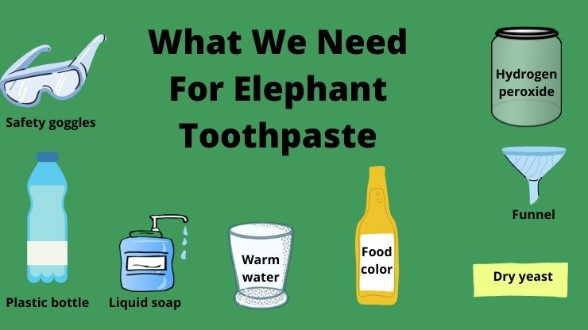

Slide 5
LabJournaal van
Datum:…………… Naam:………….………
Wat ik heb onderzocht:
Wat had ik nodig:
Werkwijze (wat heb ik gedaan):

Slide 6
LabJournaal van
Datum:…………… Naam:………….………
Resultaten: beschrijf wat er gebeurde
Analyse: Kun je verklaren wat er gebeurde?

Slide 7
Bij analyse
Probeer het volgende uit te zoeken:
Welke deeltjes er in de ingrediënten die je nodig had zitten
Zitten deze deeltjes ook in het Elephant Toothpaste?
Zoek uit wat er is gebeurd door de ingrediënten samen te voegen
Kun je dit aan anderen uitleggen? Maak iets waarmee je goed kunt laten zien wat er is gebeurd

